Slide 1

AUTOMATED ENGINEERED DOMESTIC USE AIR PURIFIER (aedap)
Presented By :
LAKSHAY SINGH(1603040046)
RISHU SHARMA(1703040044)
SATYAM MISHRA(1703040046)
SHIVAM PATODIA(1703040052)
SHUBHANK SHARMA(1703040054)
Under Supervision: Mr. Manoj Kumar Yadav
Assistant professor (ME)
IPEC (Guide)
INDERPRASTHA COLLEGE OF ENGINEERING, GHAZIABAD

Slide 2
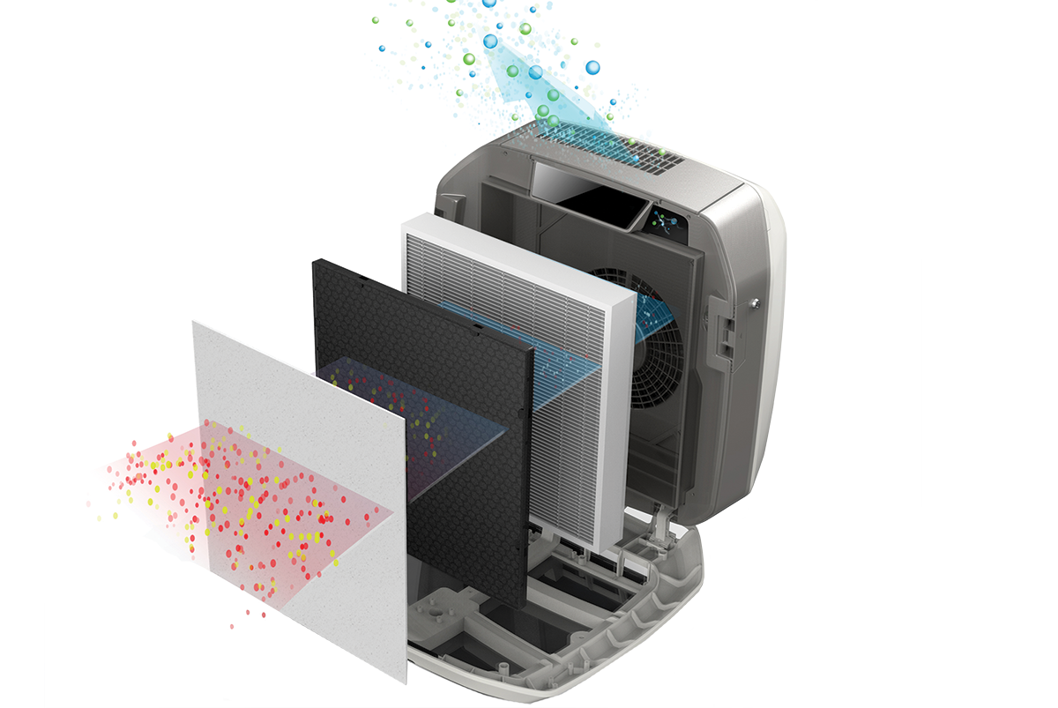
AEDAP
AEDAP consist of a multiple filters (HEPA) and a fan that sucks in and circulates air. As air moves through the filter, pollutants and particles are captured and the clean air is pushed back out into the living space.
AEDAP consists of sensor MQ 135, MQ 7 which is going send signal to Arduino Uno which is attached to electric circuit. As PPM scale of different gases and pollutants reaches inhospitable level of room or workplace, Arduino Uno is going sends an electric signal to fan and fan starts to rotated and work at the until the PPM scale reaches hospitable level and then stops and hence the cycle of AEDAP keeps on going.
This whole process will help the consumer to use the electricity judiciously.

Slide 3
Calculation
FOR CALCULATION WE NEED TO CONSIDER THREE MAIN 3 TERMS TO GET FLOW RATE
CFM
CFM stands for Cubic Feet per Minute and is the most common way to measure airflow. Areas are measured in square units (like square feet). Volumes (like a room full of air) are measured in cubic units — CFM determines how much cubic feet can be moved or exchanged each minute.
Measuring cubic feet per minute isn’t as difficult as you might think: just measure the volume of the room and divide by how quickly you want to replace the air, and that’s it!
CADR Explanation
CADR or Clean Air Delivery Rate represents an air purifier’s efficiency (not effectiveness) similar to a car’s horsepower. It Indicates how fast an air purifier can filter the whole air (volumetric) of a room within a specific time.
For example, A CADR of 200 cfm (cubic feet per minute) means it can deliver 200 cubic feet of air in every minute on its highest fan speed settings. It also can be expressed as the cubic meter per hour (m3/h).
Air Changes Per Hour
Abbreviated ACPH or ACH, or air change rate is a measure of the air volume added to or removed from a space in one hour, divided by the volume of the space. If the air in the space is either uniform or perfectly mixed, air changes per hour is a measure of how many times the air within a defined space is replaced each hour.

Slide 4
Calculation of CFM
FORMULA FOR CFM CALCULATION : (Volume * ACPH )/60
AIR FLOW RATE (Q) FOR STANDARD ROOM SIZE
Volume of Room in Feet= 15.8*15.8*10 cubic feet
Air change per hour= 6
Q= ( (15.8*15.8*10)*6 ) / 60 = 250 CFM
CFM is determination of unit’s clean air delivery rate (CADR)
CFM of a room is a mathematical process of figuring the room’s cubic area as well as the rate at which we desire the air to circulate throughout the room .

Slide 5
AQI- Air Quality index for Domestic Use
Targeted Pollutants and Gas to make hospitable environment at home or workplace
PM 2.5 And PM 10
Carbon Dioxide (CO₂)
Nitrogen Dioxide (NO₂)
Carbon Monoxide (CO)
Volatile Organic Compounds (VOCs)
Safety Level for pollutants and Gas
SENSOR | POLLUTANTS AND GAS | SAFETY LEVEL
MQ 135 | PM 2.5 | 60ppm or 35.5ug/m₃
MQ 135 | PM 10 | 100ppm or 54.ug/m₃
MQ 135 | Carbon Dioxide (CO₂) | 1000 PPM
MQ 135 | Nitrogen Dioxide (NO₂) | 5 PPM or 9mg/m₃
MQ 7 | Carbon Monoxide (CO) | 50 ppm

Slide 6
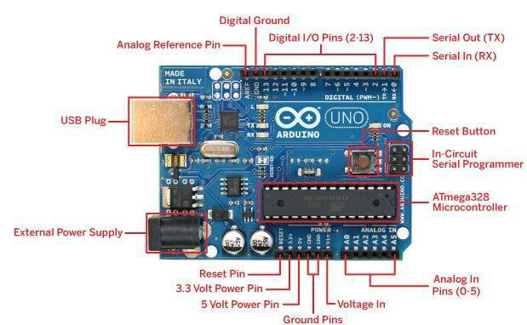
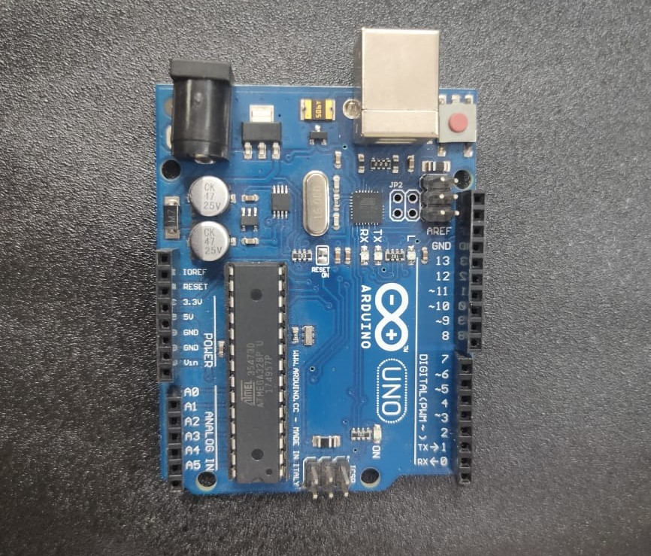
Electronic System
1. Arduino Uno
The Uno is a microcontroller board based on the ATmega328P. It has 14 digital input/output pins (of which 6 can be used as PWM outputs), 6 analog inputs, a 16 MHz quartz crystal, a USB connection, a power jack, an ICSP header and a reset button.

Slide 7
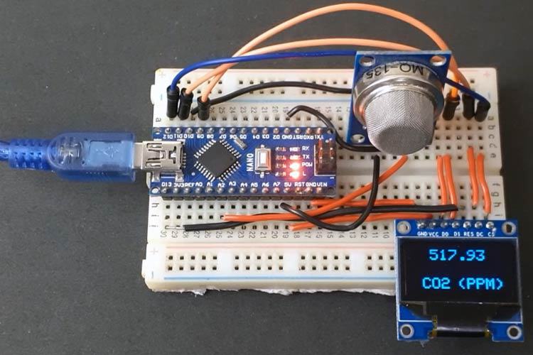
2. MQ 135 Sensor
The MQ-135 Gas sensors are used in air quality control equipment's and are suitable for detecting or measuring of NH₃, NO_{x}, Alcohol, Benzene, Smoke, CO₂. The MQ-135 sensor module comes with a Digital Pin which makes this sensor to operate even without a microcontroller and that comes in handy when you are only trying to detect one particular gas.

Slide 8
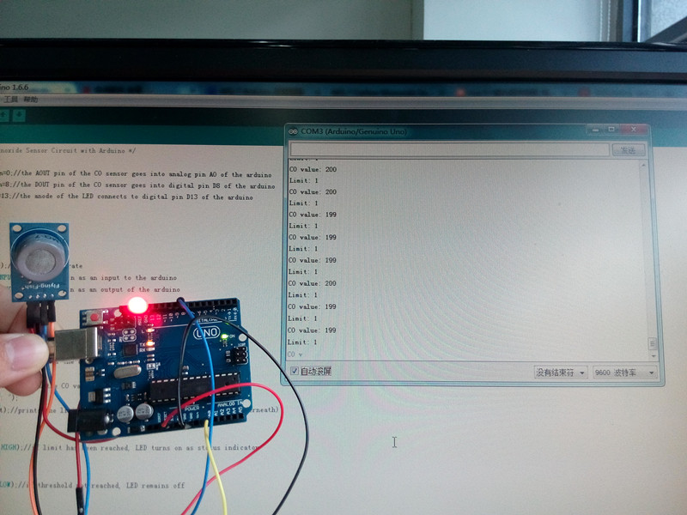
3. MQ 7 Sensor
This is a simple-to-use Carbon Monoxide (CO) sensor, suitable for sensing CO concentrations in the air. The MQ-7 can detect CO-gas concentrations anywhere from 10 to 500ppm.
This sensor has a high sensitivity and fast response time. The sensor's output is an analog resistance. The drive circuit is very simple; all you need to do is power the heater coil with 5V, add a load resistance, and connect the output to an ADC.

Slide 9
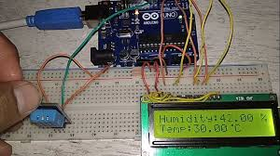
4. DHT-11
The DHT11 is a commonly used Temperature and humidity sensor. The sensor comes with a dedicated NTC to measure temperature and an 8-bit microcontroller to output the values of temperature and humidity as serial data. The sensor is also factory calibrated and hence easy to interface with other microcontrollers.

Slide 10
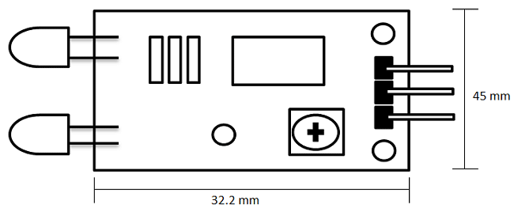
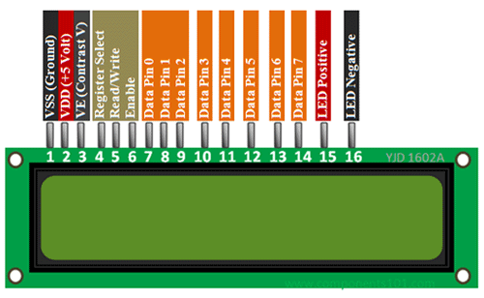
5. LCD Screen (16*2)
LCD modules are very commonly used in most embedded projects, the reason being its cheap price, availability and programmer friendly. Most of us would have come across these displays in our day to day life, either at PCO’s or calculators.

Slide 11
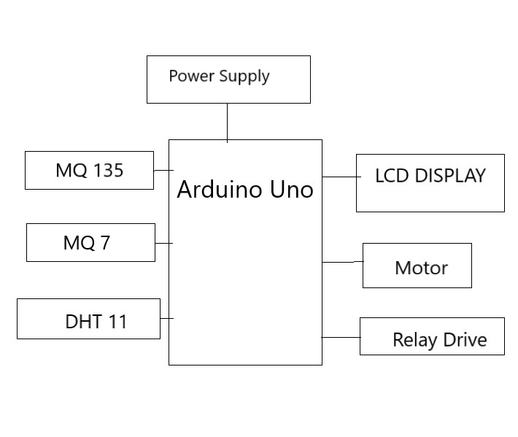
Block Diagram

Slide 12
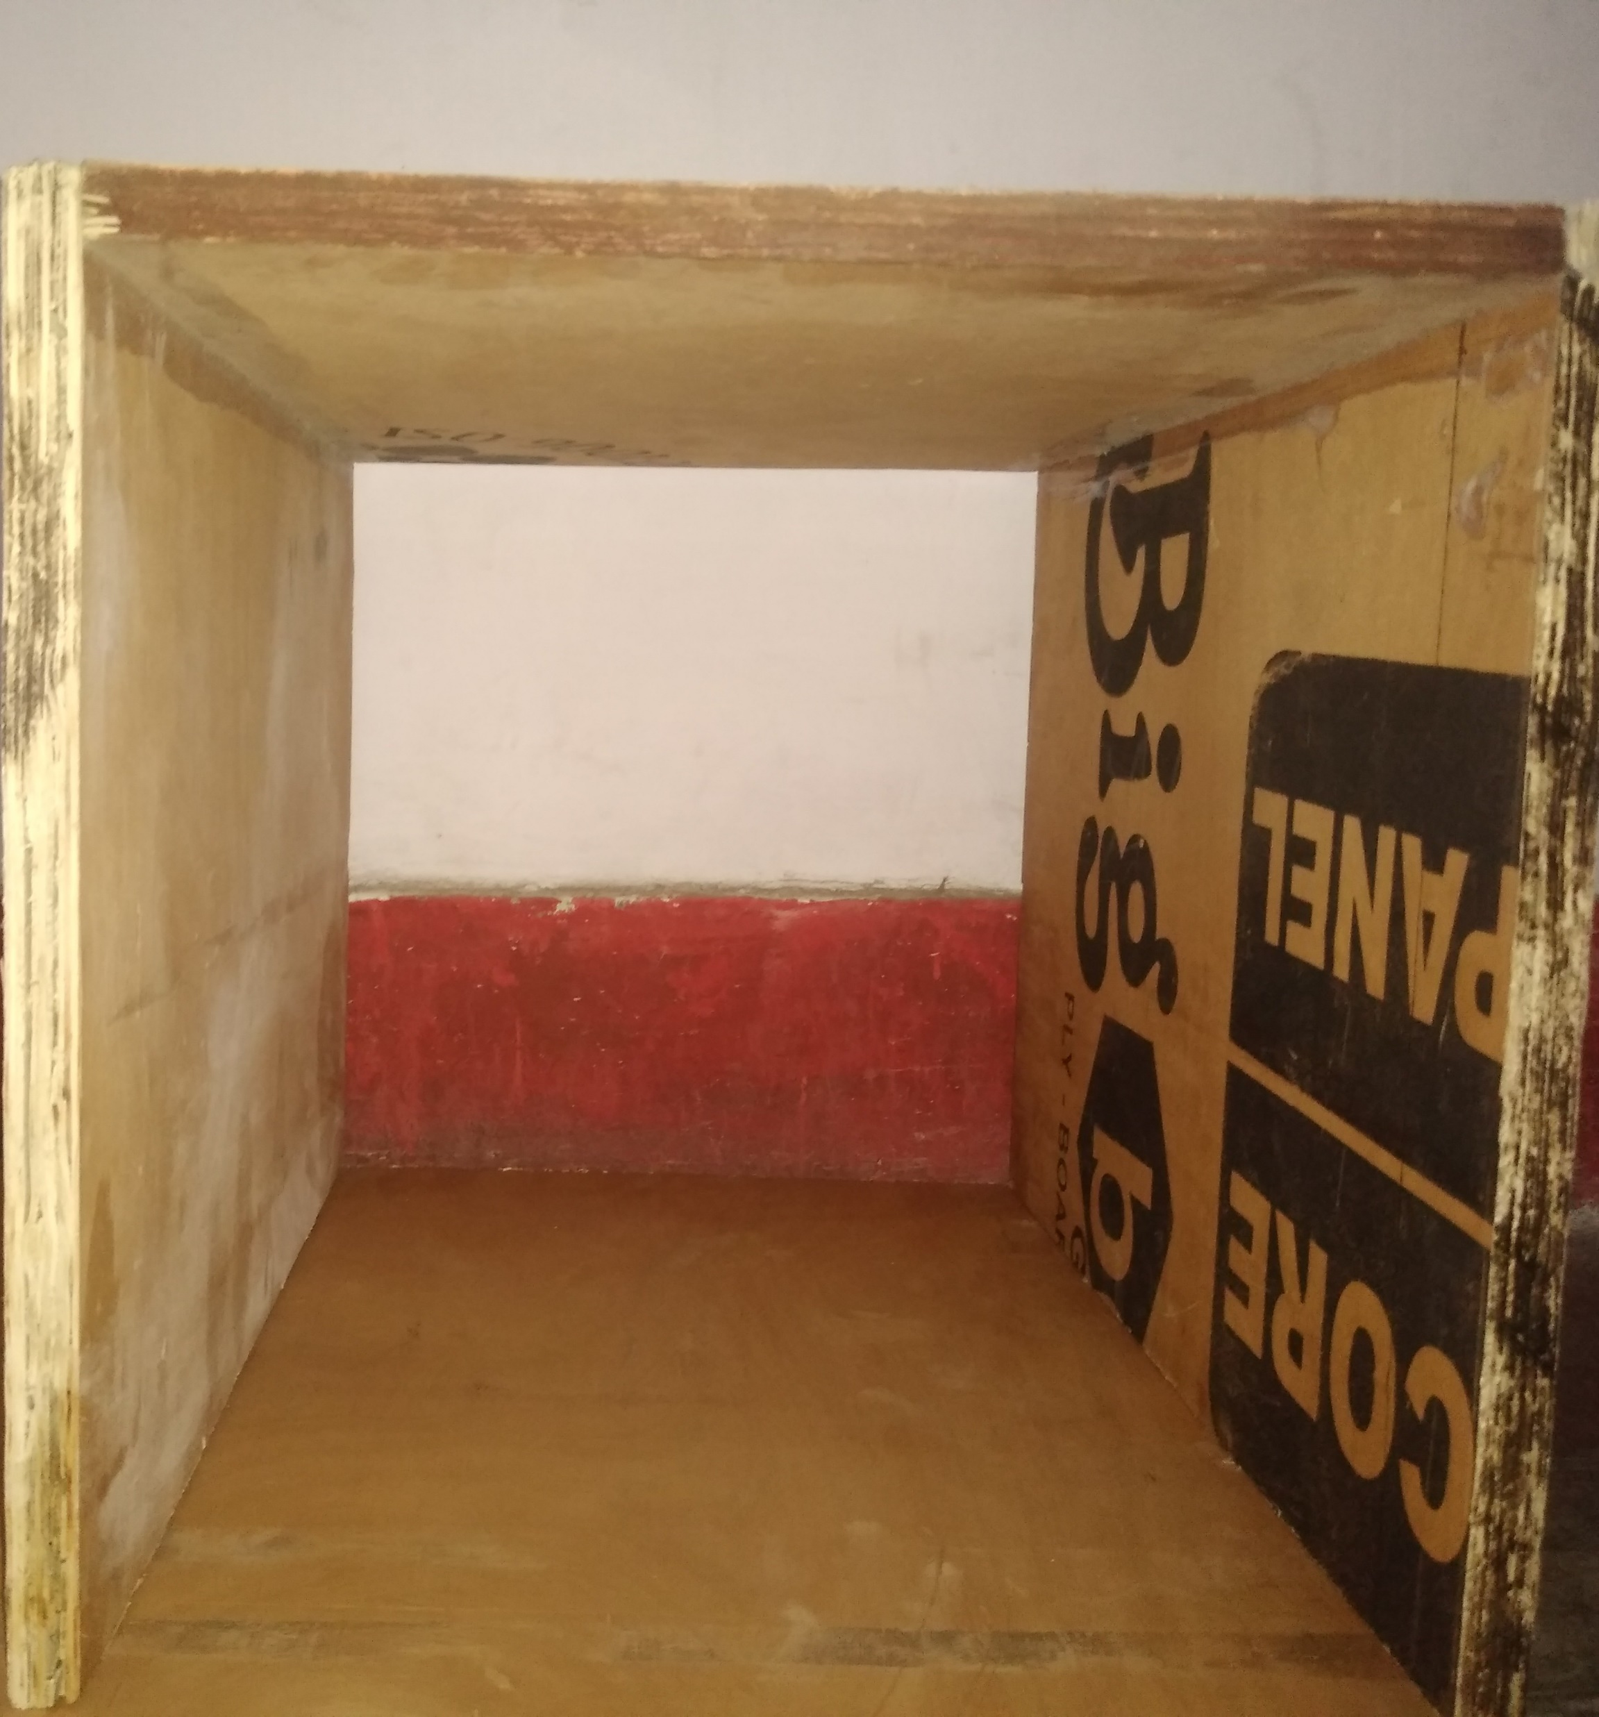
Mechanical Component
Air Cabin
Dimension: 40*32.2*38 cm

Slide 13
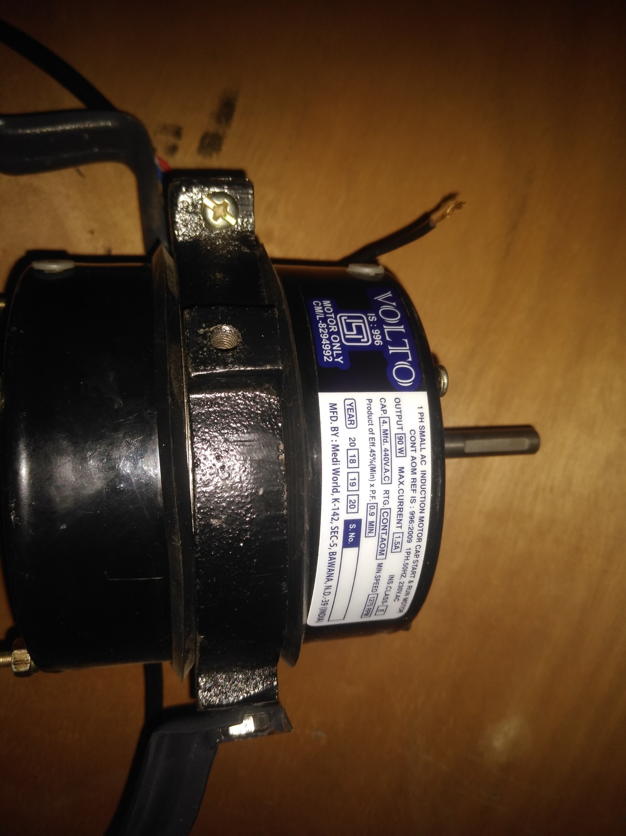
2. Fan Motor

Slide 14
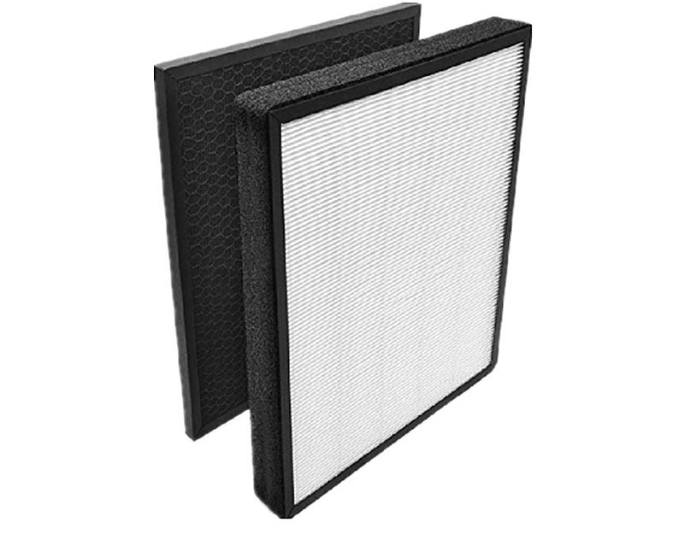
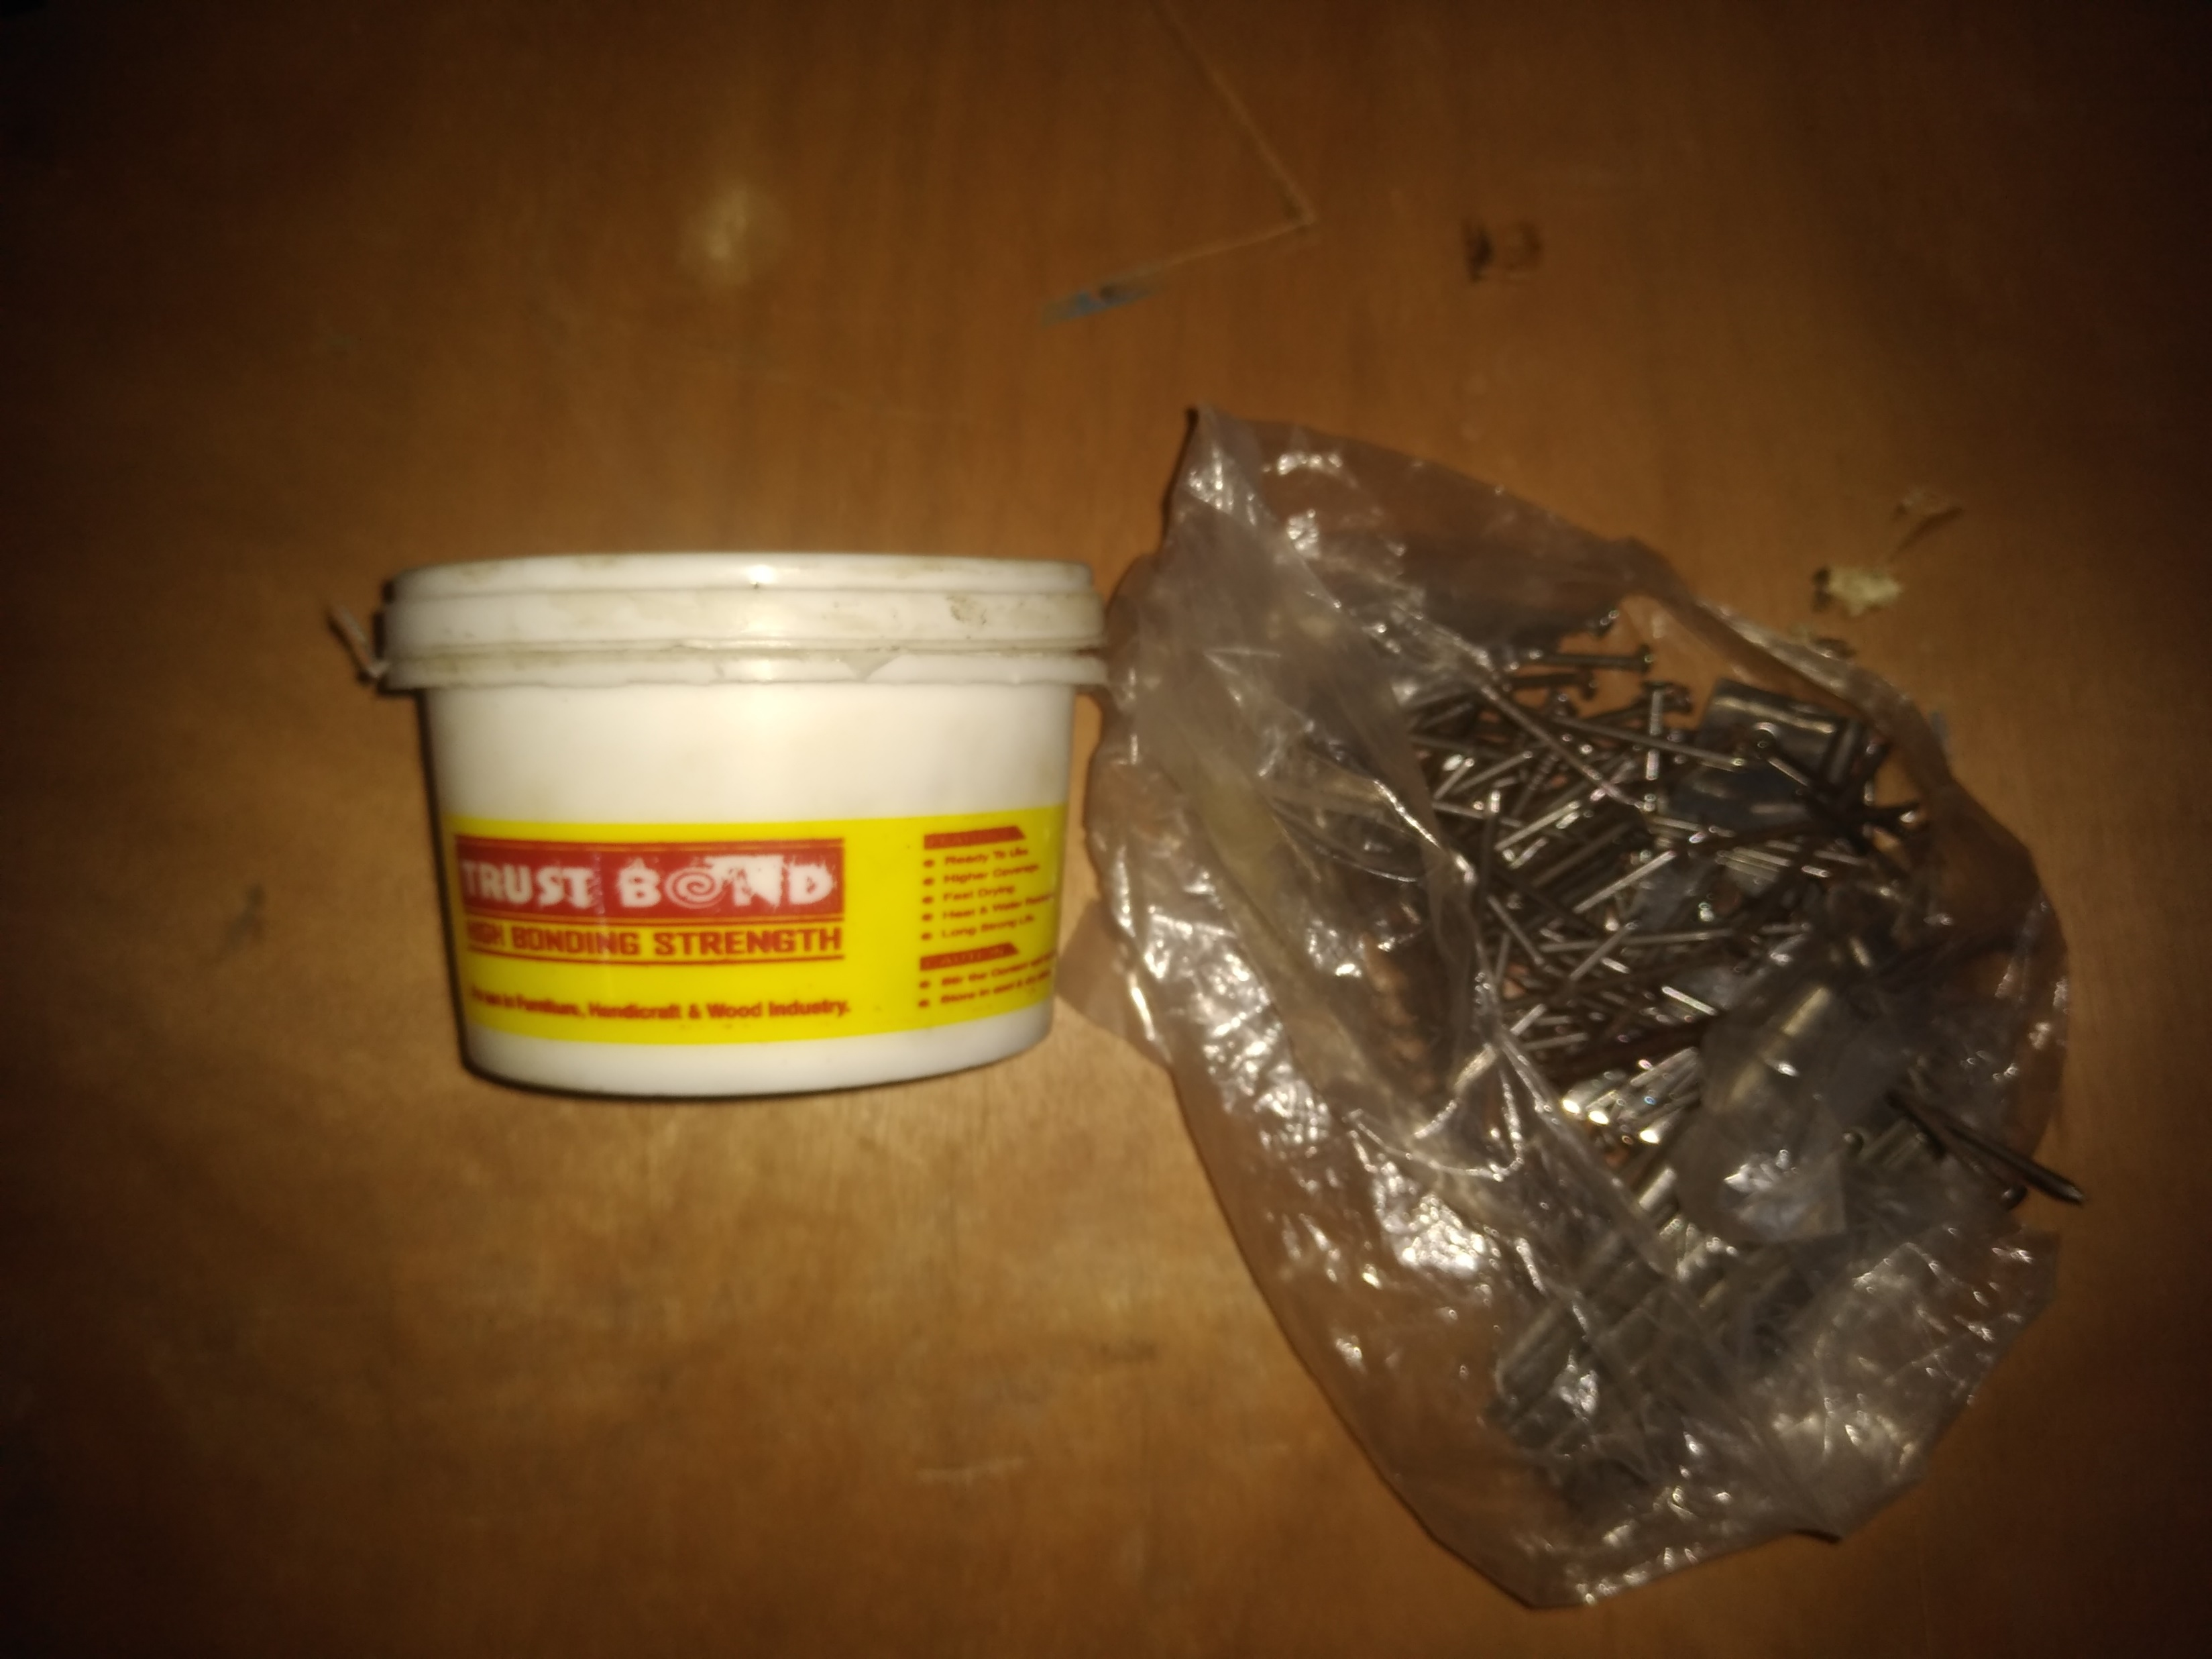
3. Filter
4. Nail And Fevicol
Filter Dimension : 35*28

Slide 15
Total Expenditure
S No. | Components | Quantity | Cost
1. | Ply Wood Board | 1 (7*3) Feet | 870
2. | Nail (1 inch) | 1 | 20
3. | Fevicol | 1 | 45
4. | Door Occupants | 5 | 80
5. | HEPA Filter | 1 | 2500
6. | Electric Plug | 1 | 40
7. | Motor and Fan | 1 | 1700
8. | Jump Wire | 2 | 250
9. | DC Power Adapter | 1 | 675
10. | Arduino Uno | 1 | 500
11. | MQ 135 | 1 | 150
12. | MQ 7 | 1 | 140
13. | DHT 11 | 1 | 130
14. | LCD Screen (16*2) | 1 | 300
15. | Jump Wire | 2 | 200

Slide 16


